Slide 1
SVELTE KIT weather app
By Alexis, Margot & Gaby

Slide 2
What is svelte KIT
Difference between svelte & svelte kit is that svelte is in react & svelte kit is in NextJS
It is a framework for build high-performance web apps.
Each page is a Svelte component
We create page in adding in routes folder

Slide 3
Why we did a weather app?
Small application that still requires enough design and code in order to properly function
Doable to finish in 1 day
It's one of the easiest ideas we've ever had
Comparing to other ideas (Cookies clicker, card game, tictactoe, mineswiper, etc) it seemed the most reasonable one
A challenge for everybody: Alexis had to design an actual app and think about features, Gaby had to manage the complete day, Margot had to learn a new language and create the app
It made it possible to help each other within the small time frame we had without losing sight of the application, meaning we got to work on our own things but still help each other

Slide 4
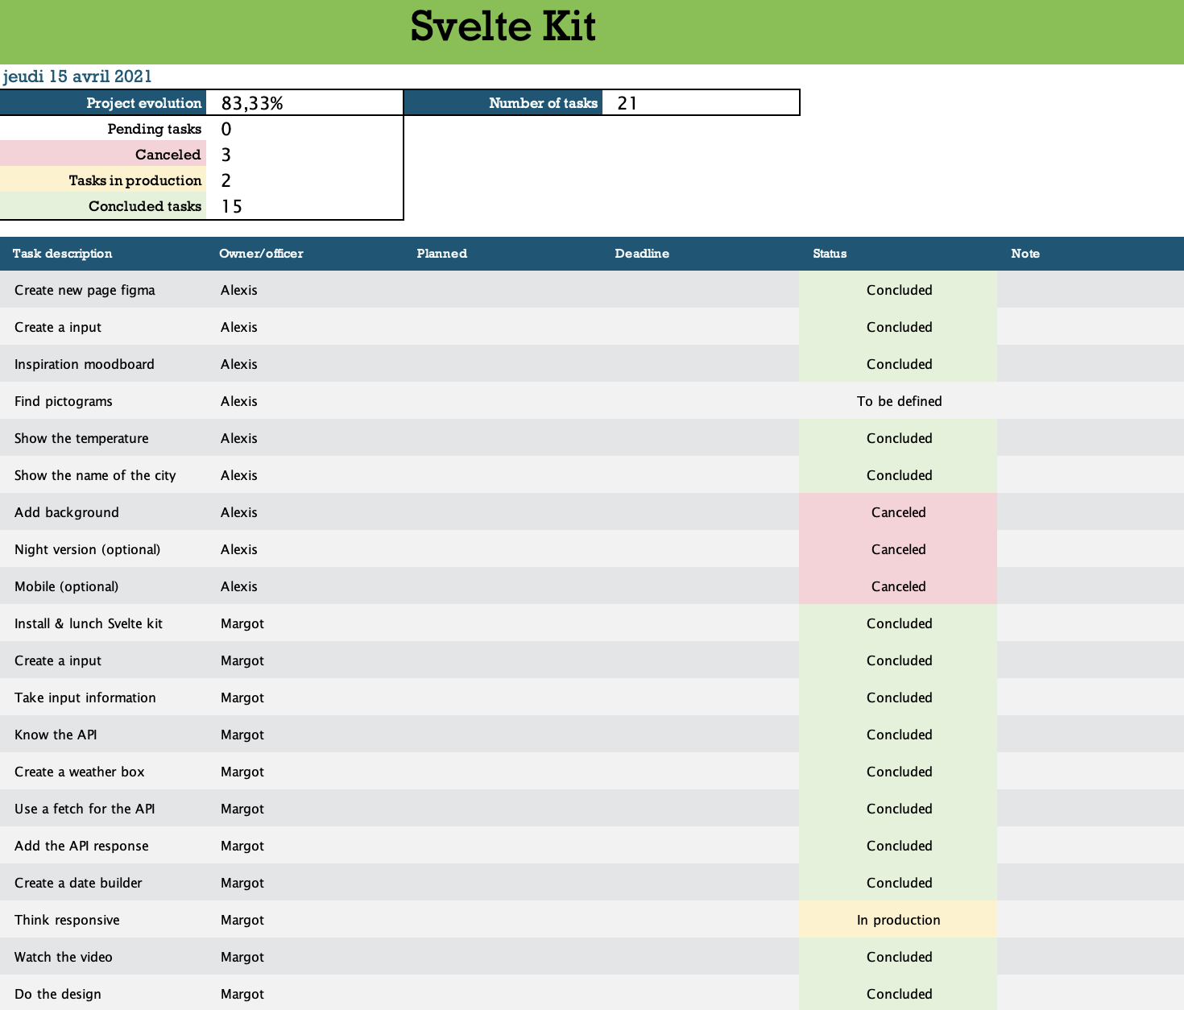
What we used to manage de project? And why?
We used Powerpoint because is a small project.
We don ’t need to use Zoho for little projects.
Powerpoint it’s easy to use when the template is do.
We can do anything you want.

Slide 5
Now, the app presentation

Slide 6
Why we used Figma
It’s collaborative
It’s user friendly (e.g. plugins)
It’s free access up to 3 projects
It’s hybrid app
Because Margot have experience with that & she can help

Slide 7
What kind of difficulties you has during the project, Alexis ?
Have an appropriate workflow
Style guide creation (colors, fonts)
A lot of things to think abou

Slide 8
And what did it bring you ? ALEXIS
Discover a totally different world than mine
Some tools and tips to create the style
Understanding why Margot is so... voilà

Slide 9
What kind of difficulties you has during the project, Margot?
Learning Svelte Kit without knowing Svelte
Trying to do learn it all in 1 day
In the beginning, the syntax, now it's quite easy to understand
When there's a bug, trying to fix it and try like 1000 different things
The constant trial and error

Slide 10
And what did it bring to you ?
It's fun to be a developer
It requires patience and a good google search skill
It's really the opposite of designing

Slide 11
What kind of difficulties you has during the project, Gaby ?
Difficulties to don’t help too much
Difficulties to giving « orders »
Respect the time (it’s so hard)
And talking in english, sometimes i don’t have the right words
The pression to finish the work bc i’m the project manager and if is not finished is totaly my fault

Slide 12
And what did it bring you ?
A little more confiance to talk in english with Margot
More cohesion with my team
It was fun but i prefer to be a developer

Slide 13
Somes questions?

Slide 14
Thank’s for watching

